Slide 1

Retail Analysis
Andrew Taylor

Slide 2
I will explore a dataset from an international online retail company spanning across 38 countries consisting of columns: InvoiceNo, StockCode, Description, Quantity, Invoice Date, UnitPrice, CustomerID, Country.
 | InvoiceNo | StockCode | Description | Quantity | InvoiceDate | UnitPrice | CustomerID | Country
0 | 536365 | 85123A | WHITE HANGING HEART T-LIGHT HOLDER | 6 | 2010-12-01 08:26:00 | 2.55 | 17850.0 | United Kingdom
1 | 536365 | 71053 | WHITE METAL LANTERN | 6 | 2010-12-01 08:26:00 | 3.39 | 17850.0 | United Kingdom
2 | 536365 | 84406B | CREAM CUPID HEARTS COAT HANGER | 8 | 2010-12-01 08:26:00 | 2.75 | 17850.0 | United Kingdom
3 | 536365 | 84029G | KNITTED UNION FLAG HOT WATER BOTTLE | 6 | 2010-12-01 08:26:00 | 3.39 | 17850.0 | United Kingdom
4 | 536365 | 84029E | RED WOOLLY HOTTIE WHITE HEART. | 6 | 2010-12-01 08:26:00 | 3.39 | 17850.0 | United Kingdom
The data ranges from 12/1/2010 – 12/9/2011

Slide 3

Using the 541,909 rows and 8 columns of data to identify trends to answering the following questions
What items are most frequently bought together?
What are our top 5 products with the highest revenue?
Is there any seasonality for our top 5 products?
What is the best month for revenue?
What day of the week is the best day for revenue?
What is the best hour for revenue?
What time during each day should we display advertisements to maximize liklihood of customers buying product?
Where are most of our customers?
What are our top/least 5 countries in revenue?

Slide 4

Which 2 products are most frequently bought together?
787 key fobs were bought together
579 key fobs and back doors were bought together
543 pink polkadot bags and red retrospot bags were bought together
543 key fobs and sheds were bought together
473 key fobs and front doors were bought together
466 red paisley bags and red retrospot bags were bought together
450 orders consisted of coffee and sugar

Slide 5
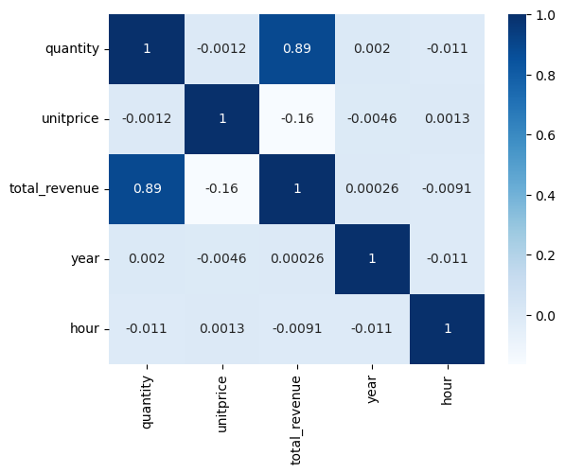
Notable Correlations?
Notes:
No real notable correlations here

Slide 6
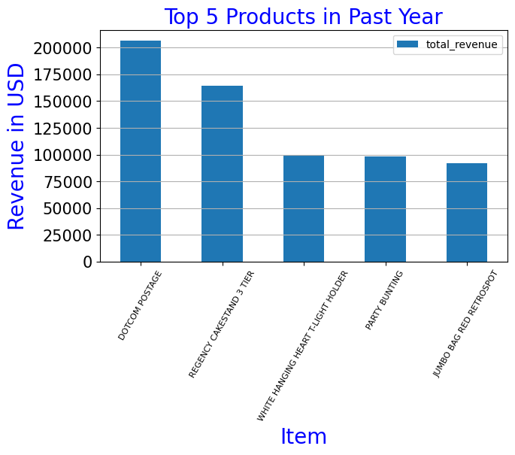
What are our top 5 items in most revenue?

Slide 7
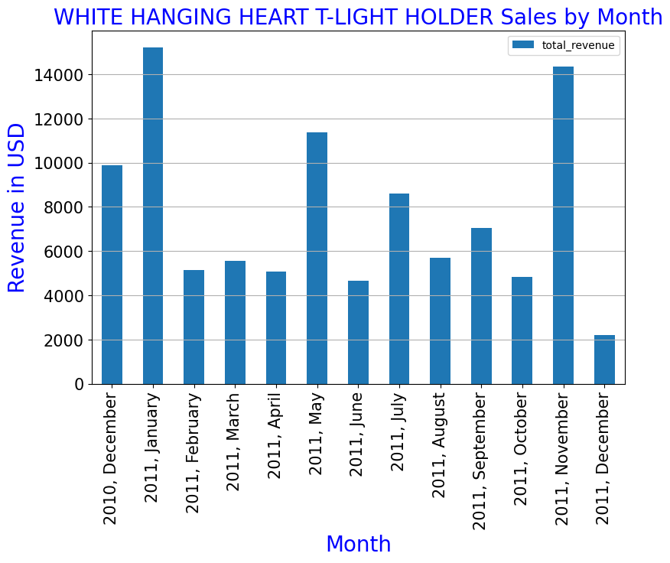
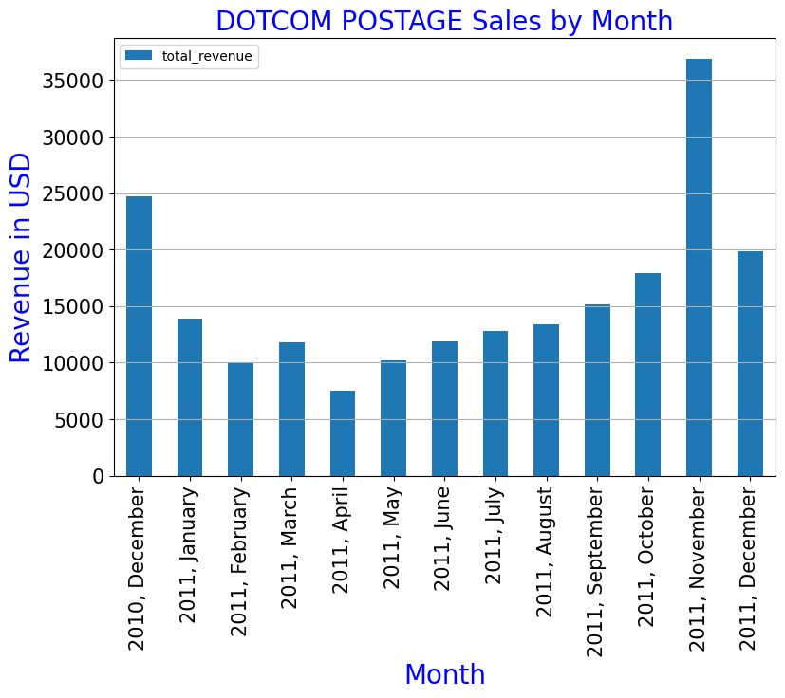
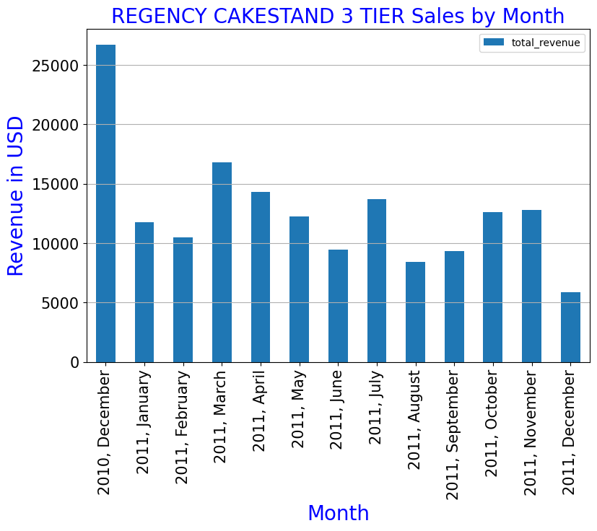
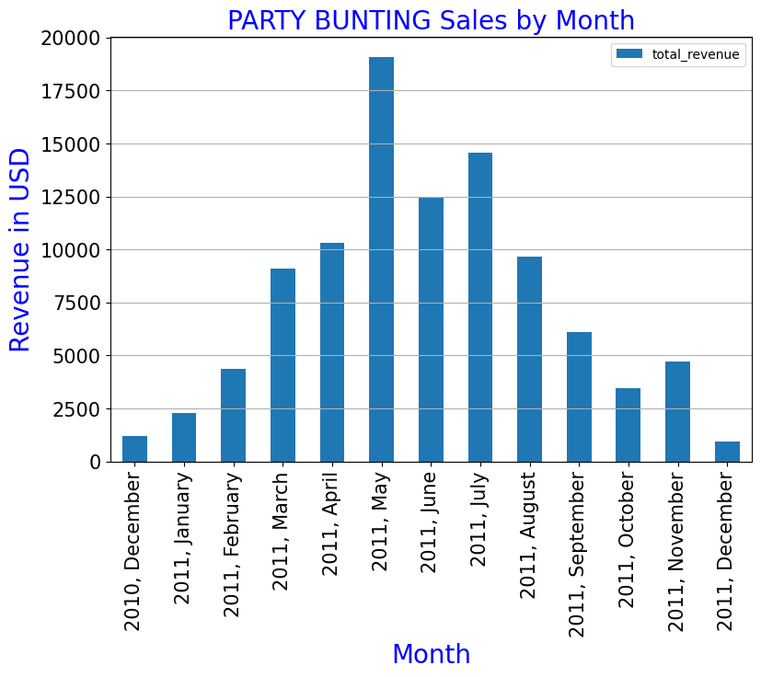
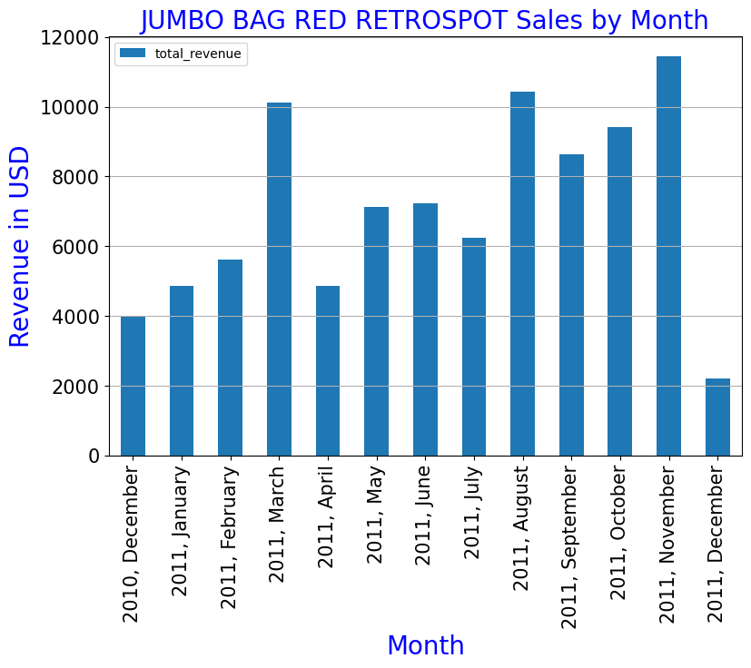
Is there any seasonality to our top 5 products with the most revenue?
Notes:
Top 5 Products Seasonality Analysis:
Our WHITE HANGING HEART T-LIGHT HOLDER sales appear have higher revenue in the winter months. There was an uptick in sales in May 2011. We could market more prior to and during the winter season, and investigate further to understand why sales had a boost in May 2011.
Our DOTCOM POSTAGE item has trended upwards from June to November. December 2011's data is cut off, since the dataset ends at 12/9. Going forward, we could strategize to market more and more, as we move from June to December, with the most marketing in November/December.
Our REGENCY CAKESTAND 3 Tier seems to have a steady pace throughout the year, and upticks in Decemeber. The data for December 2011 falls short because the data ends on December 9th. This item appears to be the most consistent item in our top 5
Our PARTY BUNTING item had an uptick in sales between March and August, and hit it's peak in May. This could be because most parties are held during this time (March - August). Maybe we could do better by intentially putting this item in front of the partiers during the warmer months in the year.
Our JUMBO BAG RED RETROSPOT trended upward from August to November, and had a spike in March. This item appears to fall short in december 2011, but the dataset ends on December 9th. We could give this item extra attention to find out what is driving sales, and exploit the sales drivers

Slide 8
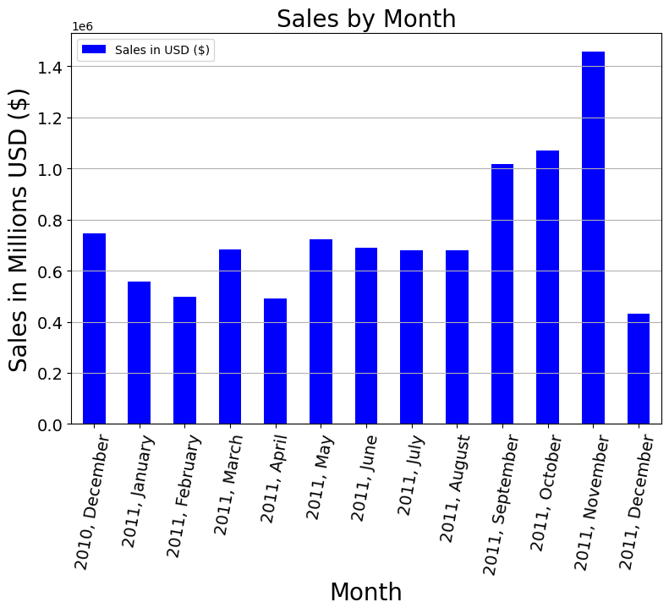
What is the best month for sales?
Notes:
The best month for sales in this dataset was November 2011. December 2011 could have had a considerable run if the dataset didnt cut off on December 9th.

Slide 9
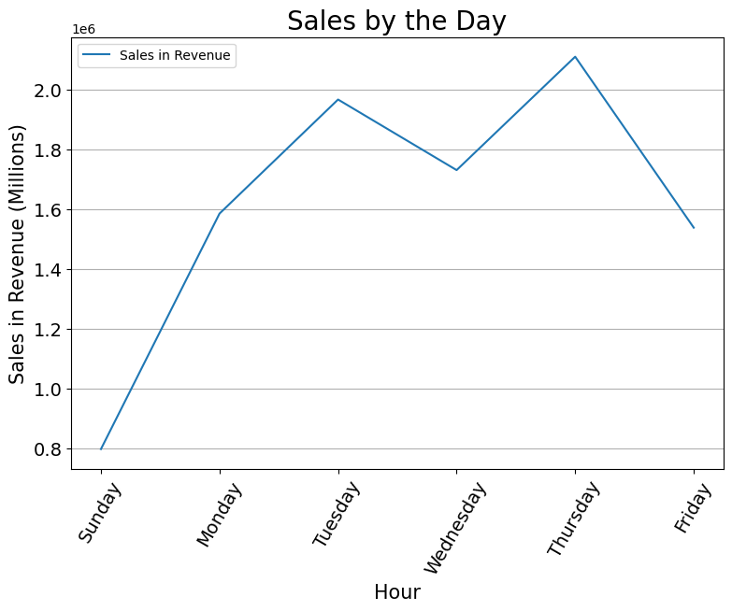
What is the best day for sales?
Notes:
We experience most of our sales during the weekday. Apparently, we dont get any sales at all on Saturdays, and the least amount of sales on Sundays. We could do better by exploiting the marketing trends we use mid week, and applying the same methods to the weekend, may it be based on online traffic, location, or demographic. A lot of people don't work weekends, and have their hands free to shop, so this could be a lucrative marketing venture.

Slide 10
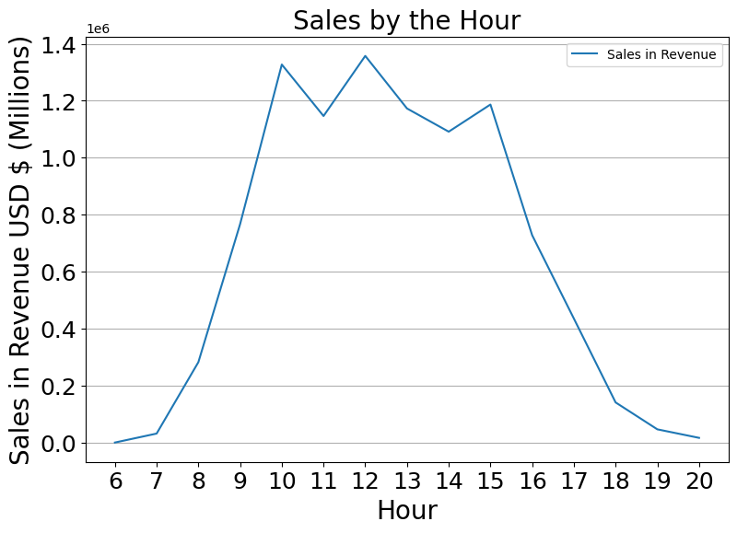
What are our best hours for sales?
Notes:
Most of our sales take place between 9AM and 4PM. We will see later that the united kingdom is response for an overwhelming amount of sales.
We could investigate further to identify trends for countries with alternate time zones. It's interesting that most of our revenue is generated not only during the weekday, but also during work hours. Our customers are likely to be shopping at work. This information may be used to assume that our customers are employed, and further, to assume that there may be a correlation between the amount of revenue generated from our customers (Countries) and their national gdp/income levels.¶

Slide 11
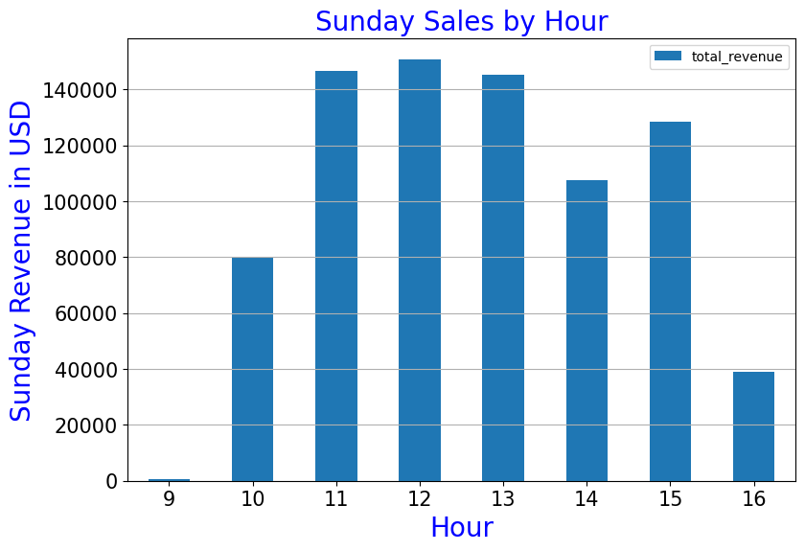
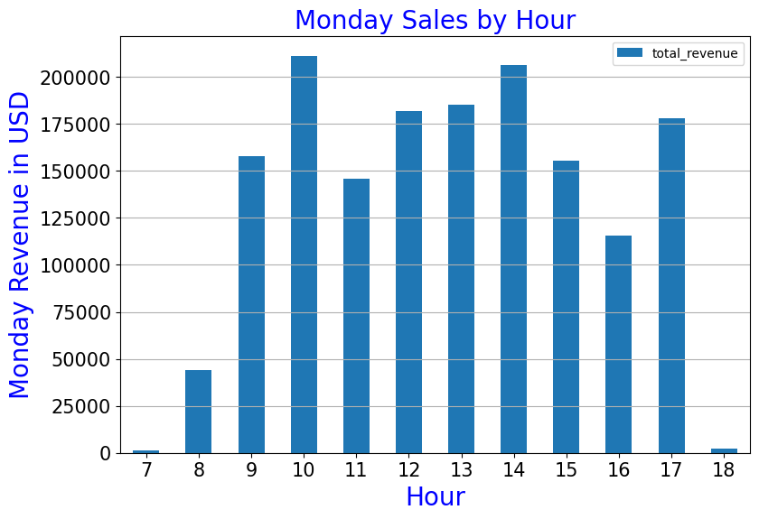
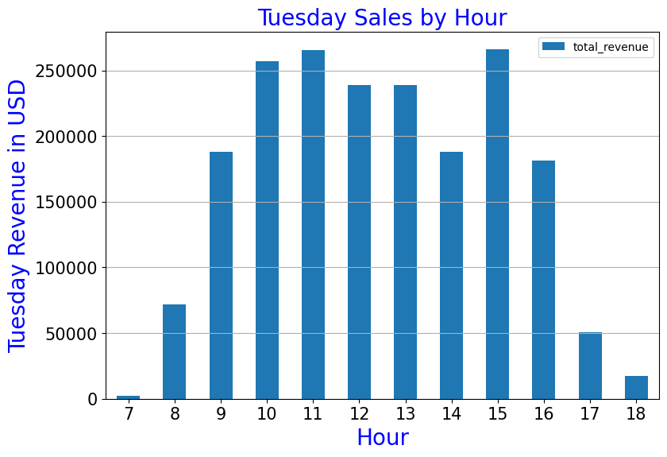
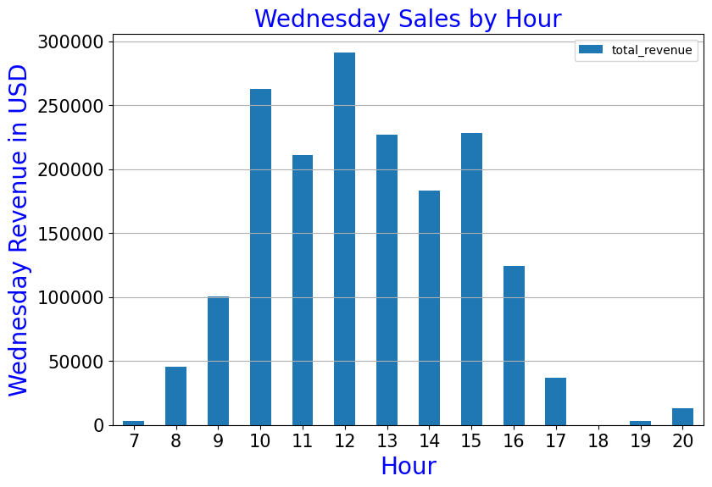
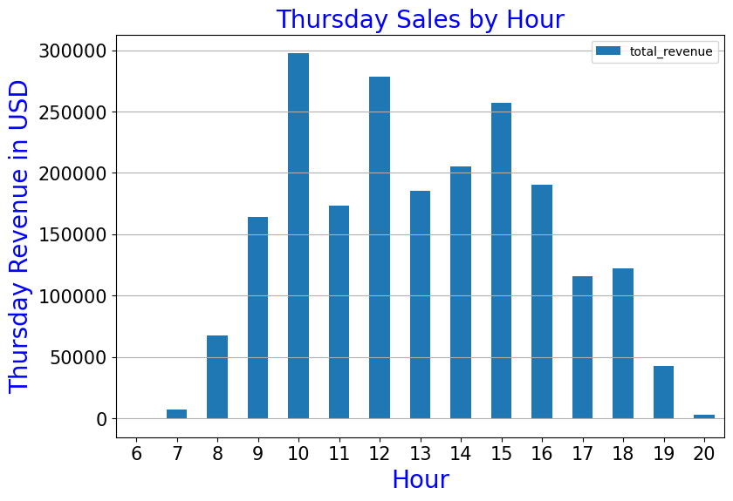
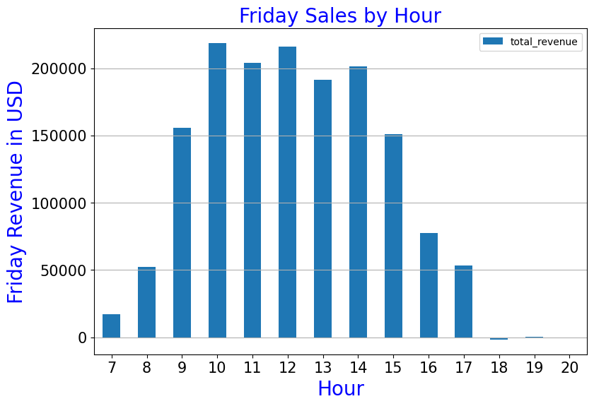
Sales by day, by hour
Notes:
This data could be used to understand when to use platforms such as social media to market, or when to showcase deals so they get maximum visibility

Slide 12
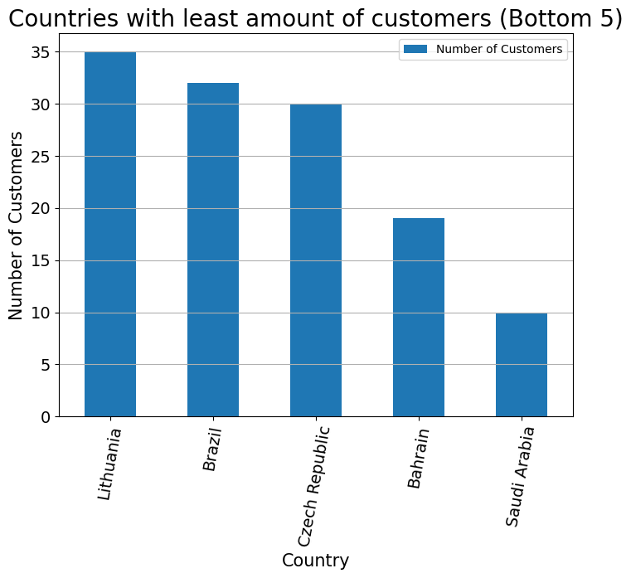
Countries with least amount of customers (bottom 5)

Slide 13
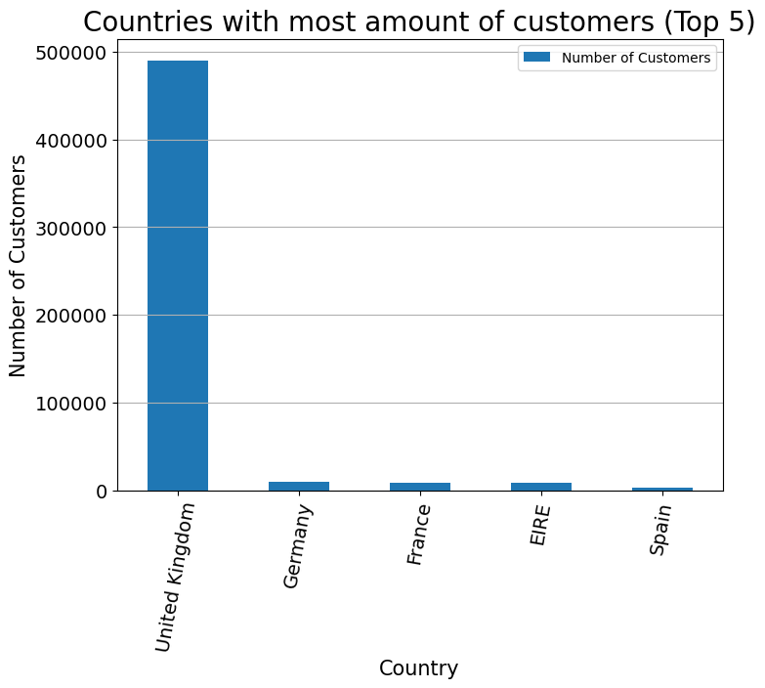
Countries with most amount of customers (top 5)

Slide 14
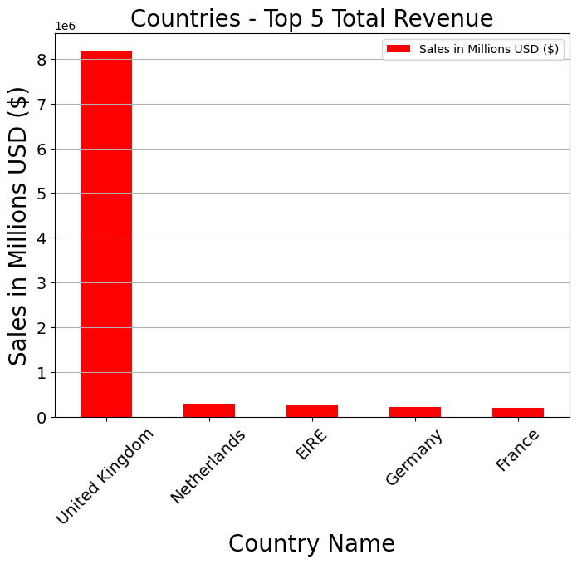
Top 5 Countries in Sales

Slide 15
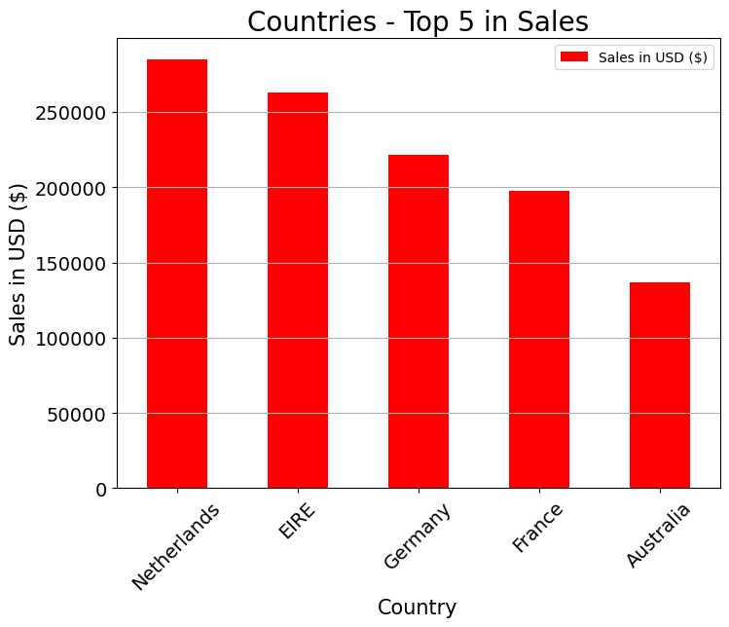
Top 5 Countries in Sales (without United Kingdom)
Notes:
We are exposed mostly to the United Kingdom. We could do well by marketing to other countries with a similar demographic as that in the United Kingdom. We can see more clearly in the plot below, that the top 5 countries just below the United Kingdom (which holds the number 1 spot in our total revenue rankings) all have made more than 100,000 USD in purchases. We could aim to increase those numbers by tailoring our marketing to their demographic and understanding our competitors

Slide 16
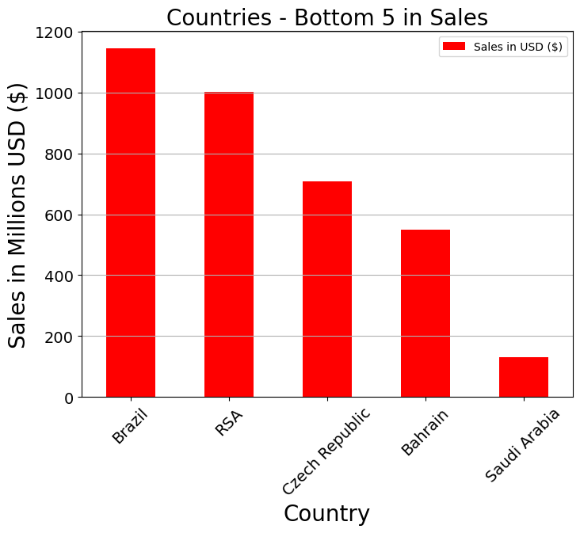
Countries with least amount of sales in USD
Notes:
For these customers (countries), we could weigh the cost of marketing versus ROI. We might be better off not increasing marketing attempts to demand more dollars from these countries, and target countries with more buying power, and interest in our products. On the other hand, we can investigate further to determine why these countries are so low in sales, and try to mitigate those obstacles.

